Slide 1
Raspberry Pi
Lecture 3
Ⓒ 2018 ECSESS RoboElectronics Committee, Slides adapted from Dirk Dubois

Slide 2
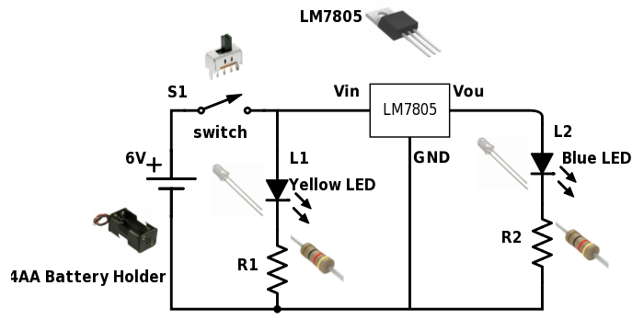
Python and Pyboards from last week
Learned about basics of Python and how Pyboards work
Ⓒ 2018 ECSESS RoboElectronics Committee, Slides adapted from Dirk Dubois
‹#›

Slide 3
Final Project
Design a soccer player robot
Ping-pong ball
Powered by a Raspberry Pi and controlled via phone over WiFi
Competition at the last workshop
1 vs 1 or 2 vs 2
Complete specification next workshop?

Slide 4
Today’s Tasks
Get the Pi 0 working?
...
Link to starter code : https://github.com/HanYangZhao/RoboElectronics
Pyboard API : http://docs.micropython.org/en/latest/pyboard/pyboard/quickref.html#

Slide 5
What is a Raspberry Pi?
A single board computer
OS: Raspbian (Linux)
More than a simple microcontroller
Hundreds of example projects online

Slide 6
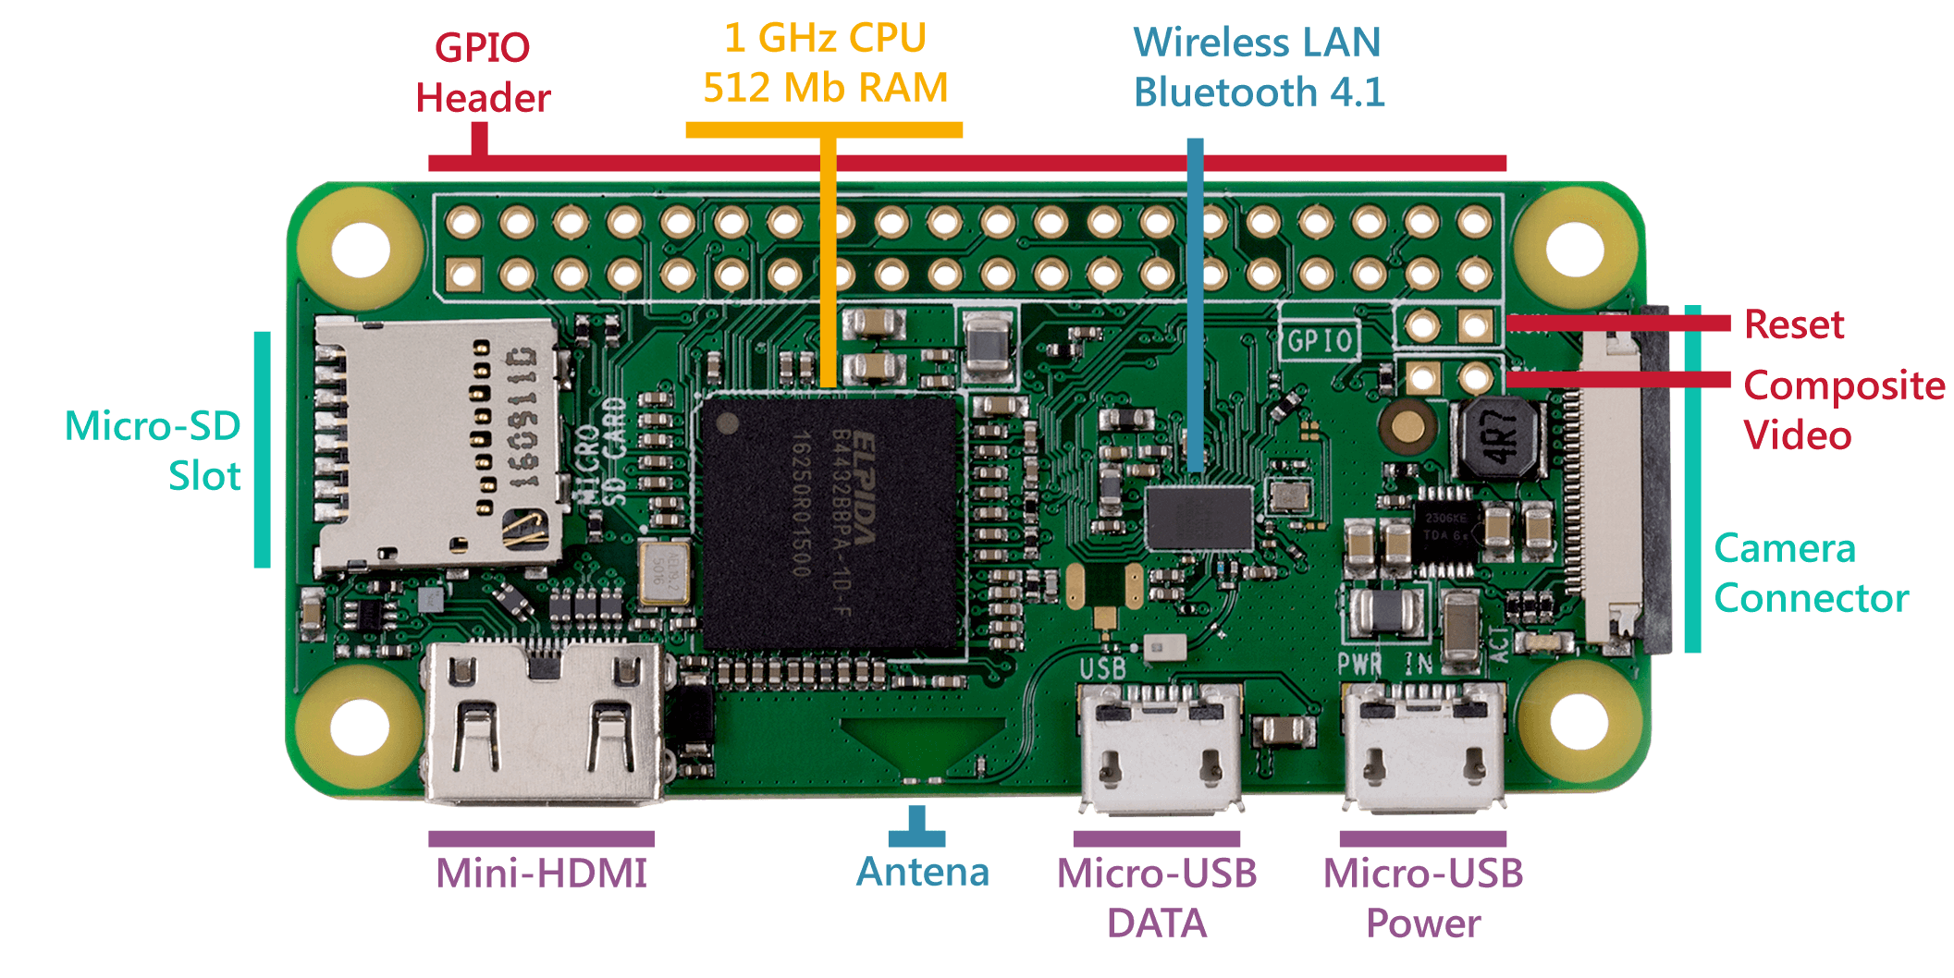

Slide 7
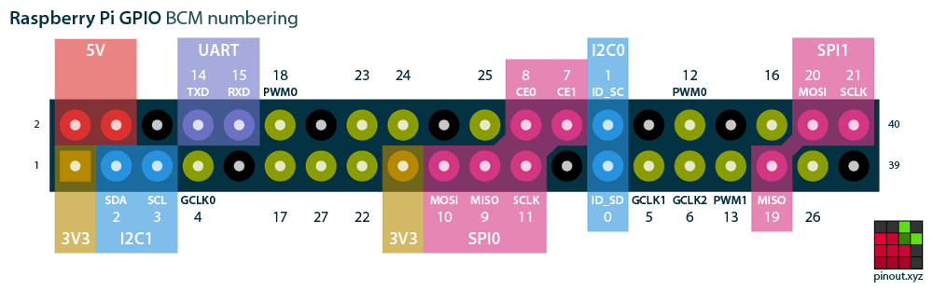
No ADC on the RPi

Slide 8
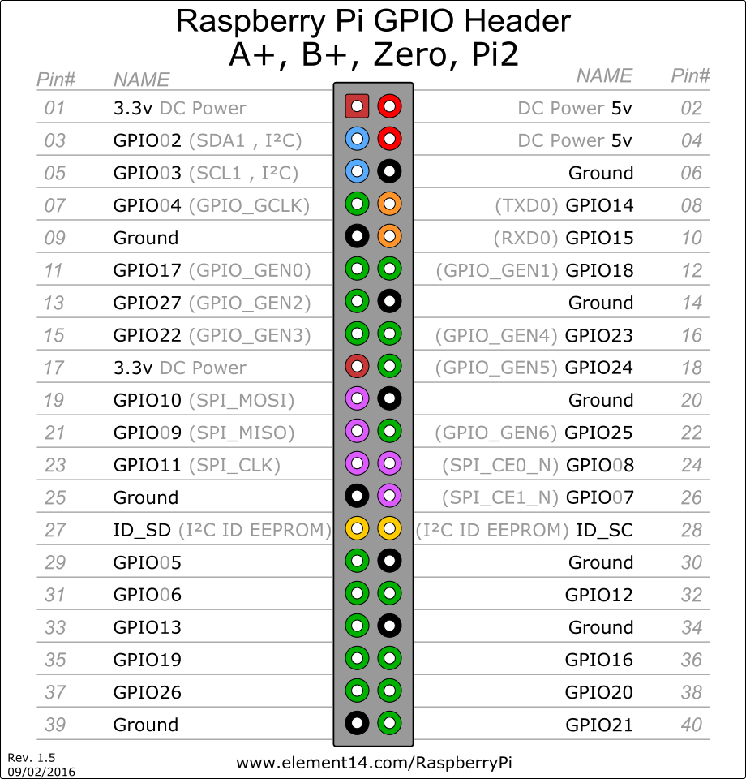
Two way to define pins in code
GPIO numbering
Physical Numbering
All GPIO pins are 3.3V rated and NOT 5V tolerant

Slide 9
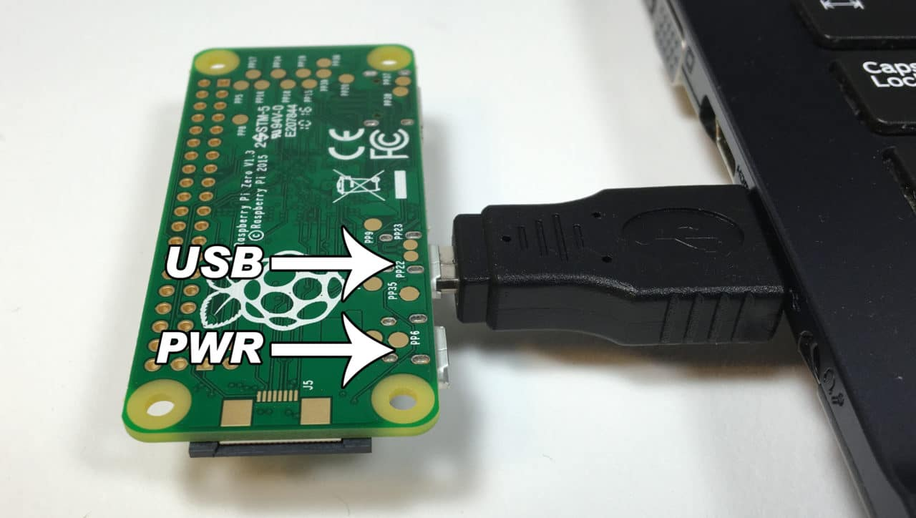
Getting Started
The Pi’s have been preconfigured to run the OTG mode with other customizations
Plug in the Pi 0
Ssh into the pi 0
Write your code!

Slide 10
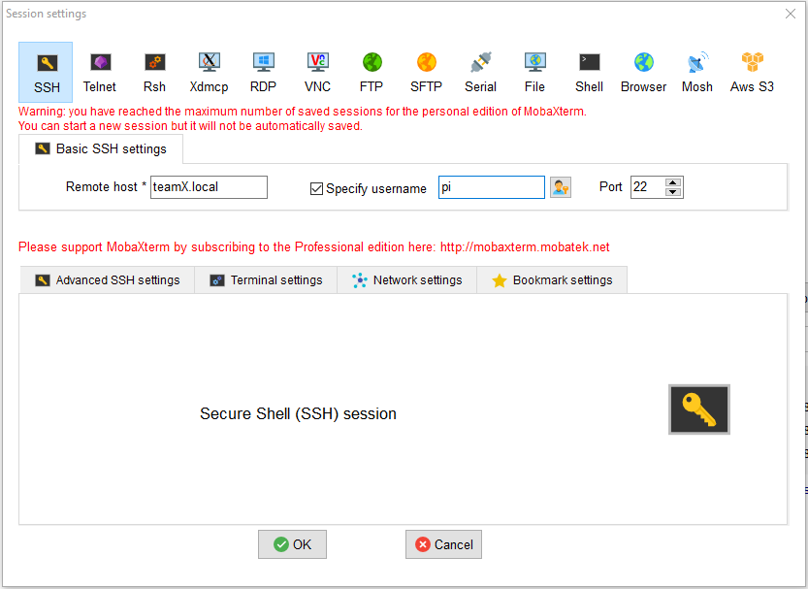
How to SSH
Linux/Mac
Open terminal
ssh pi@teamX.local
Password : raspberry
Windows
Install MobaXterm or Putty
Install bonjour services
Putty
Hostname : teamX.local
Port : 22
Username : pi
Password : raspberry
Open MobaXterm
Click Session->SSH
Remote host : teamX.local
Username : pi
Password : raspberry

Slide 11
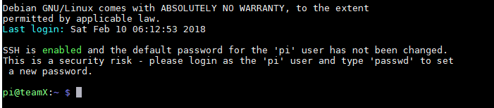
Linux Basics
The terminal UI
Pre-dates GUI
Keyboard only
Does more or less everything a GUI can do
If you work with servers you’ll be dealing with terminals a lot

Slide 12
Linux Basics
Running commands in linux
Linux comes with a set of predefined programs
Usually there is a built in manual
“Program name” -man or with -h
Programs can be run under different privileges
For programs that need to access/edit system files, we need to run the program with sudo
E.g. ( sudo vi ….)

Slide 13
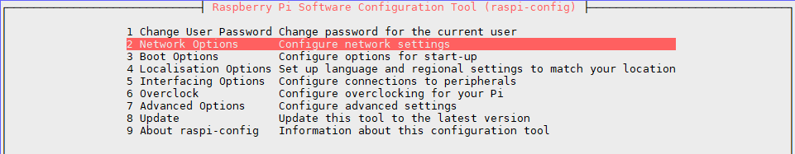
Linux Basics
Changing hostname
sudo raspi-config
This will open a program, navigate using keyboard only
Select Networking
Select Hostname
Type team# where # is your team number,press OK
Finish
Reboot
When you ssh again you’ll need to put team#.local instead of teamX

Slide 14
Linux Basics
Navigation
cd folder to go into that folder
cd folder/insideFolder to go 2 levels
cd ../ to go to the previous folder or ../../ for 2 levels up
cd ~ to go to the home folder of the current user
Folders and files
ls to list all files and folders in current directory
Mkdir dirName to create a new directory called dirName
touch filename to create a new file called filename
cp original_file_path new_file_path for copying file, use mv filename new_path to move file
mv -r or cp -r to move and copy folders

Slide 15
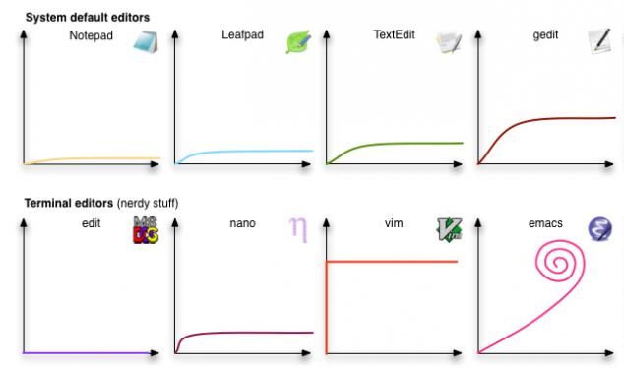
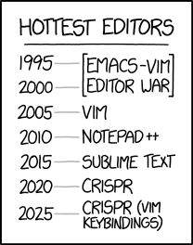
Linux Basics
Editors
Nano
Similar to notepad
nano filename
Ctrl + O to save, Ctrl + X to leave
Vim
More advanced than nano
3 modes : Command/Insert/Visual
vim filename
:w to save, :q to exit, :q! to exit without saving

Slide 16
Linux Basics
Connecting to McGill’s wifi
Open /etc/wpa_supplicant/wpa_supplicant.conf
sudo nano /etc/wpa_supplicant/wpa_supplicant.conf
This is a system file so you need the admin privilege
It should be set up to something like this
country=GB
ctrl_interface=DIR=/var/run/wpa_supplicant GROUP=netdev
update_config=1
network={
ssid="wpa.mcgill.ca"
priority=1
proto=RSN
key_mgmt=WPA-EAP
pairwise=CCMP
auth_alg=OPEN
eap=PEAP
identity="YOURMCGILLID"
password="YOURMCGILLPASSWORD"
phase1="peaplabel=0"
phase2="auth=MSCHAPV2"
}

Slide 17
Enter you mcgill username and password in the required fields
Type sudo reboot to reboot (you’ll need to ssh again to login)
Check wifi status
Type ifconfig in terminal -> and look for wlan0 (wifi) -> inet addr. The IP address is your Pi’s ip address.

Slide 18
Linux Basics
Connecting to regular wifi
For regular home wifi with WPA2 you’ll need to add this in the wpa_supplicant.conf
network={ ssid="testing" psk="testingPassword" }

Slide 19
Linux Basics
SSH over the network
Using the same instructions as before but replacing teamX with the IP address you got from the previous step
Your computer needs to be connected to McGill’s Wifi
You can also try to ssh by using simply team# instead of team#.local

Slide 20
Linux Basics
File Transfer over SSH:
Windows
On Moba just drag and drop
Linux/Mac
OTG
scp /path/to/source/file pi@team#.local:/path/to/destination
Network
scp /path/to/source/file pi@IPADDRESS:/path/to/destination

Slide 21
Linux Basics
Git
Used for source code revisioning
We’re going to use it to grab the example code
Type in terminal
git clone https://github.com/HanYangZhao/RoboElectronics
This will create a new folder called RoboElectronics
Type cd RoboElectronics to enter it

Slide 22
GPIO interfacing
We need to install the RPi.GPIO module
Type sudo pip3 install rpi.gpio
Should be already installed

Slide 23
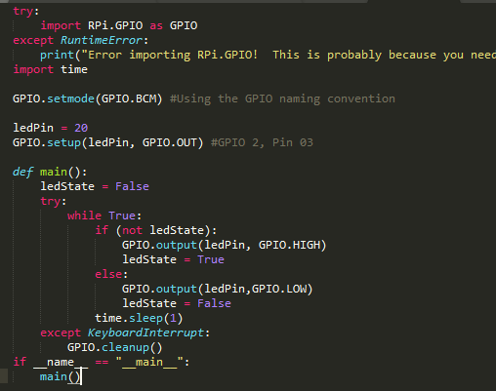
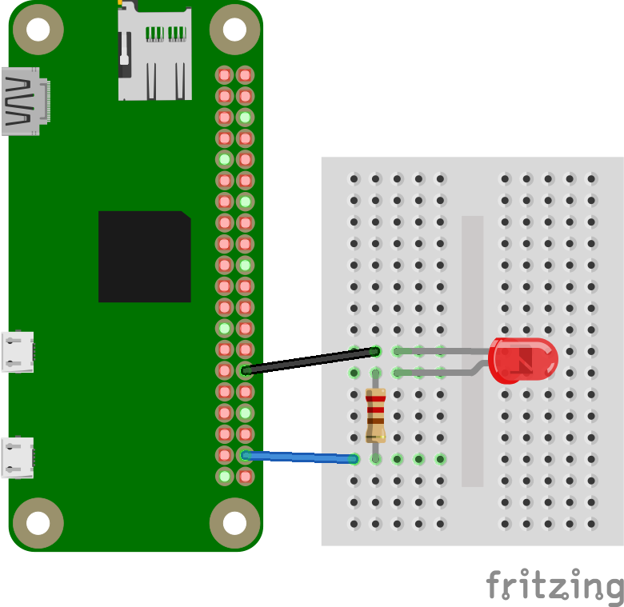
LED again
Run the code : Type python3 led.py from the RoboElectronics directory

Slide 24
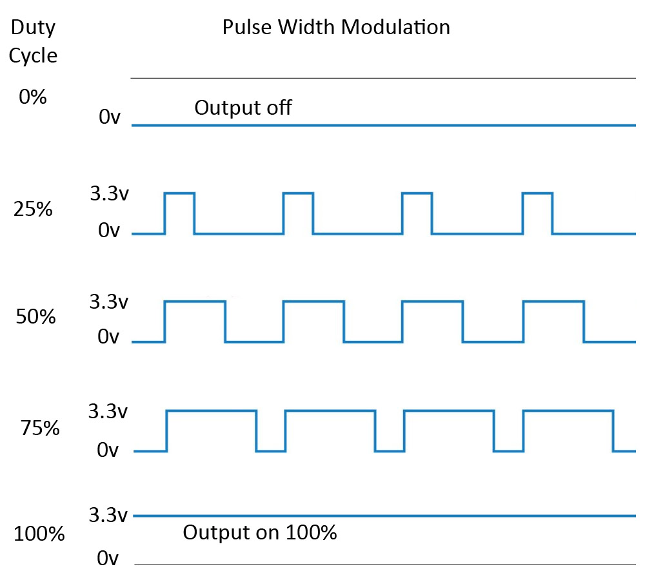
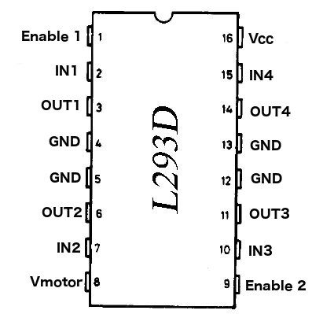
Motors and PWM
A technique for getting analog results with digital means. Digital control is used to create a square wave, a signal switched between on and off. This on-off pattern can simulate voltages in between full on (5 Volts) and off (0 Volts) by changing the portion of the time the signal spends on versus the time that the signal spends off

Slide 25
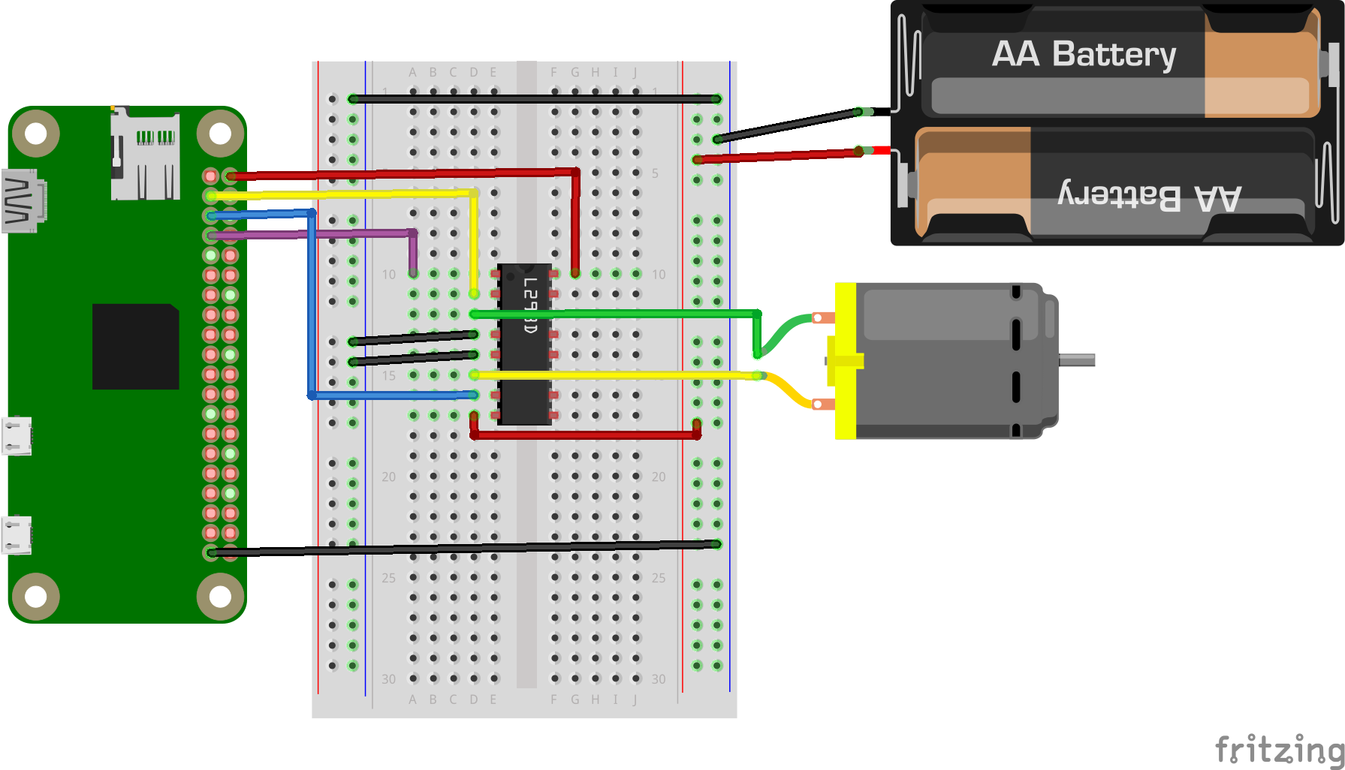
Motors and PWM
The purple wire is the PWM line

Slide 26
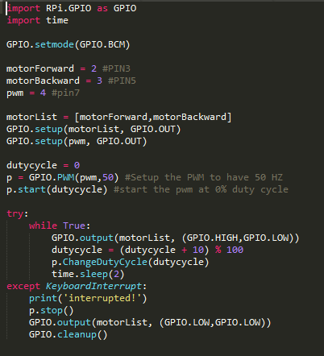
Motors and PWM
Define the GPIOs in a list
Modulo function that sets the duty cycle back to 0 at every 10 increment
Need to cleanup the GPIO pins when you exit the code, otherwise their output value will stay

Slide 27
Today’s Tasks
Turn on and off an external LED
Turn on and off both motors with PWM
Link to starter code : https://github.com/HanYangZhao/RoboElectronics
RPi.GPIO API : https://sourceforge.net/p/raspberry-gpio-python/wiki/Examples/

Slide 28
Next Week
REST API
How to control the motors on your pi via a web page
Flask servers
Simple javascript

